Slide 1
BIEN 401 Biomedical Mass Transport Class 9 Exam 1 Review
notes prepared by
Dr. Louis Reis
Created on 3/25/2022

Slide 2
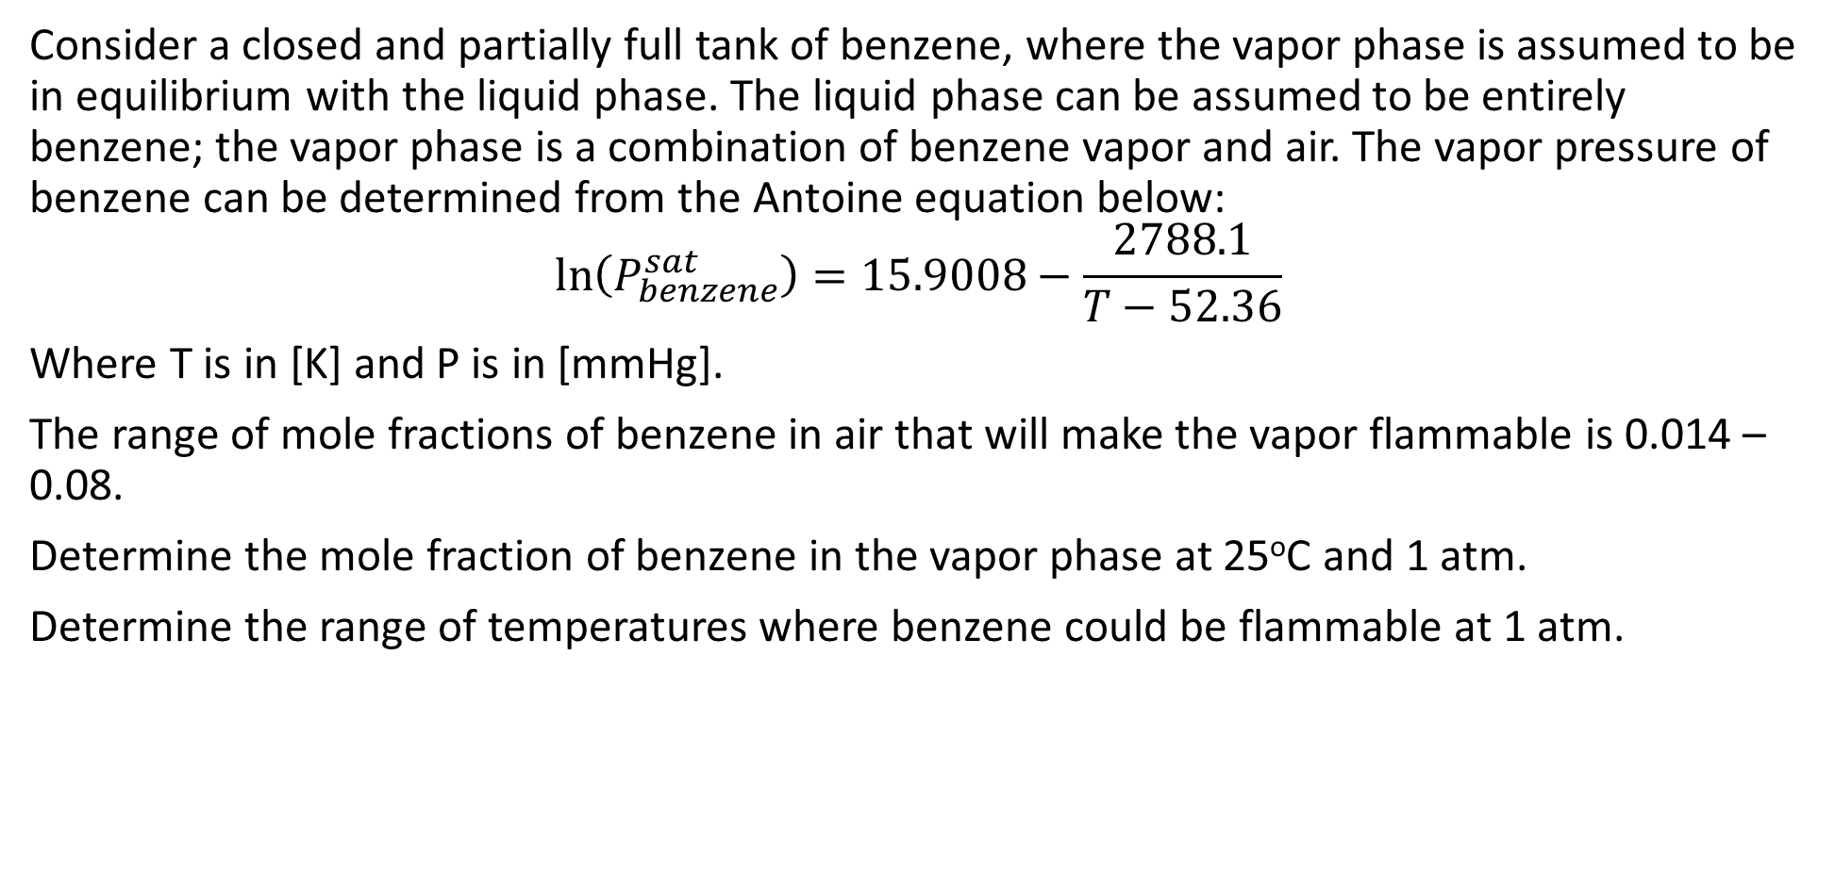
Problem 1
Consider a closed and partially full tank of benzene, where the vapor phase is assumed to be in equilibrium with the liquid phase. The liquid phase can be assumed to be entirely benzene; the vapor phase is a combination of benzene vapor and air. The vapor pressure of benzene can be determined from the Antoine equation below:
$$\ln\left(P_{benzene}^{sat}\right)=15.9008−\frac{2788.1}{T−52.36}$$
Where T is in [K] and P is in [mmHg].
The range of mole fractions of benzene in air that will make the vapor flammable is 0.014 – 0.08.
Determine the mole fraction of benzene in the vapor phase at 25ºC and 1 atm.
Determine the range of temperatures where benzene could be flammable at 1 atm.

Slide 3
Problem 1 Solution

Slide 4
Problem 1 Solution

Slide 5
Problem 2
Estimate the filtrate flux at 20ºC for the filtration of a protein solution across a membrane that is impermeable to the protein. The hydraulic conductance of this membrane is 0.01 mL cm⁻² psi⁻¹ min⁻¹. The hydrodynamic pressure drop applied across the membrane is equal to 15 psi, and the protein concentration in the solution being filtered is equal to 22 g per 100 mL. The molecular weight of the protein is 69,000 g/mol.

Slide 6
Problem 2 Solution

Slide 7

Problem 3
The diffusivity of a molecule in a solvent at 25ºC was experimentally found to be $4×{10}^{−6} cm^{2}/s$. The viscosity of the solvent at these conditions is 0.86 cP. Estimate the molecular weight of the molecule.

Slide 8
Problem 3 Solution

Slide 9
Problem 3 Solution

Slide 10
Problem 4
A hollow fiber membrane separator with a nominal molecular weight cutoff of 100 kDa is fed a solution of proteins at a rate of 250 mL/min. The composition of the protein solution is protein A (4 g/L; MW = 20,000), protein B (7 g/L; MW = 150,000), and protein C (6 g/L; MW = 300,000). The filtrate flow rate is found to be 116.2 mL/min and the flow rate of retentate is found to be 133.8 mL/min. The concentration in protein A in the retentate is found to be 5.84 g/L. What is the concentration of A in the filtrate? What are the concentrations of B and C in the retentate?

Slide 11
Problem 4 Solution

Slide 12
Problem 4 Solution

Slide 13

Problem 5
Consider a two-layer model of an artery, as shown below. The layers have thicknesses of $R_{o}−R_{1}$ and $R_{1}−R_{i}$. The inner layer has a diffusion coefficient of $D_{i}$; the outer layer has a diffusion coefficient $D_{o}$. The concentration within the lumen is constant at $C_{i}$. The concentration outside the arterial wall is $C_{o}$.Determine the effective diffusion coefficient.

Slide 14
Problem 5 Solution

Slide 15
Problem 5 Solution

Slide 16
Problem 5 Solution

